Slide 1



MORSE
CODE GAME
Presented By Mansi Kumari(1262251426), Ria Mudhole(1262251691), Sejal Talele(1262252623), and Neha Avhad(1262252511)

Slide 2
INTRODUCTION
Morse Code is a method of encoding text into dots and dashes.
Used in telecommunication and military communication.
This project simulates a Morse decoding training game.
Developed using C programming language.

Slide 3
PROBLEM
To design and develop an interactive Morse Code training game in C that helps users practice decoding Morse signals using audio feedback and timed responses, while tracking performance through a scoring system.

Slide 4
OBJECTIVE
Objective 1
Objective 2
The objective of this project is to design and implement an interactive Morse Code Training System that generates random alphabet signals and converts them into Morse code with corresponding audio sounds. The system allows users to practice decoding signals in a structured and engaging manner.
It also aims to accept user input within a time limit, compare it with the correct Morse code, and evaluate performance using a scoring mechanism. Through this project, fundamental C programming concepts are applied in a practical and real-world application.

Slide 5
SYSTEM FEATURES
01
02
The Morse Code Training System generates random alphabet letters and converts them into corresponding Morse code signals with audio output. It provides an interactive console interface that allows users to practice decoding signals in structured rounds.
The system accepts user input within a time limit, compares it with the correct Morse code, and updates the score accordingly. At the end of the session, it displays the final score and performance rank to evaluate the user’s accuracy.

Slide 6
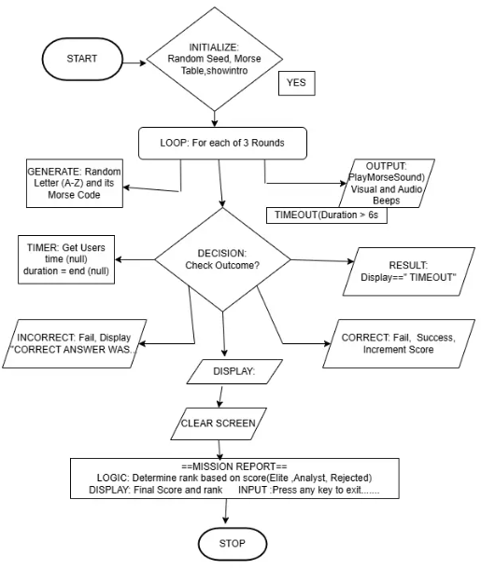
WORKING ALGORITHM
1. Initialize system and display intro screen.
2. Generate random alphabet letter.
3. Play Morse code sound for that letter.
4. Accept user input within time limit.
–5. Compare input with Morse table.
–6. Update score and display final rank.

Slide 7
PROGRAM STRUCTURE
•morseTable[] → Stores Morse values of A–Z.
• playMorseSound() → Plays dot/dash sounds.
• showIntro() → Displays startup animation.
• main() → Controls game logic and scoring.

Slide 8
ADVANTAGES
• Improves Morse code learning.
• Interactive and engaging.
• Simple console-based implementation.
• Can be extended into GUI version.

Slide 9
ADVANCEMENTS
•Add word decoding mode.
• Add difficulty levels.
• Add leaderboard system.
• Convert to GUI using C++ or Python.

Slide 10
CONCLUSION
• Successfully implemented Morse Code training game.
• Demonstrated use of arrays, sound, and time functions.
• Useful mini project for first-year programming students.

Slide 11
THANK YOU
We Appreciate Your Time. Any Questions?

